Slide 1
Global and EU perspective on microbial food safety
‘On the road to Innovation Union: European food legislation’
Marcia Oliveira
Food Chemistry and Technology, Teagasc Food Research Centre
Email: marcia.oliveira@teagasc.ie
FOODstars
Notes:
I will talk about ‘’ Global and EU perspective on microbial food safety ‘’ and for that, first of all I will give you an overview about Food Safety and then I will go through the microbiological criteria in food

Slide 2
Food Safety
Refers to all those hazards, whether chronic or acute, that make food injurious to the health of the consumer
Improper agricultural practices
Poor hygiene at all stages of the food chain
Lack of preventive controls in food processing and preparation
Contaminated raw materials, ingredients, water and equipment
Inadequate and improper storage
Notes:
Some Factors contributes to potential hazards such as:

Slide 3
Microbial Food Safety
Microorganisms
Bacteria
Moulds and Yeasts
Viruses
Algae
Parasites
Pathogens – Food Safety
- illness, disease and death
Spoilage – Food Quality
- poor quality, short shelf life, off flavours
Notes:
Types of microorganisms include bacteria, moulds ....
They can be pathogens and then be related to Food Safety and cause illness, disease and death to humans
Or they can be spoilage microorganisms and be related to food quality and be responsible for poor quality, short shelf life and off flavours of food

Slide 4
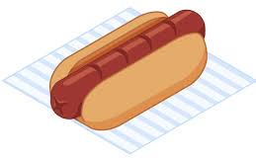
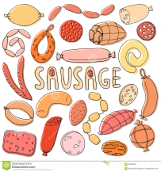
Food – Foodborne pathogens association
Ready-to-eat foods: deli meat, hot dogs, fermented and dry sausages, luncheon meats
- L. monocytogenes
Meat, Poultry, and Seafood
- Campylobacter jejuni (beef and poultry)
- E. coli O157:H7 (ground beef and pork)
- L. monocytogenes (pork, poultry, and seafood)
- Clostridium botulinum (seafood)
- Vibrio cholera (seafood)
Notes:
New information on food safety is constantly emerging.
Recommendations and precautions for people at high risk are updated as we learn more about preventing foodborne illness.
Mainly, we can divide food in 4 food categories and associate their main foodborne pathogens as following:

Slide 5
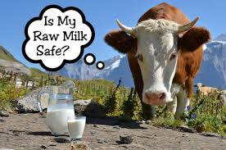
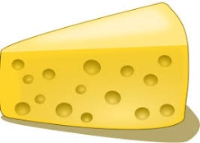
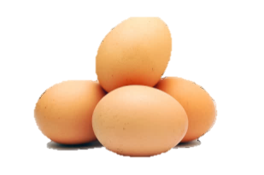
Food-Foodborne pathogens association
Dairy and Raw Egg Products
- E. coli O157:H7 (raw milk)
- L. monocytogenes (raw milk and cheese)
- Salmonella (raw milk and raw and undercooked eggs)
- Staphylococcus aureus (dairy products)
- Yersinia enterocolitica (dairy products)
Fruits, Vegetables, and Juices
- Cyclospora, parasite (produce)
- E. coli O157:H7 (juice/cider and produce)
- Noroviruses (produce)
- Salmonella (juice and produce)
- Shigella (produce)

Slide 6
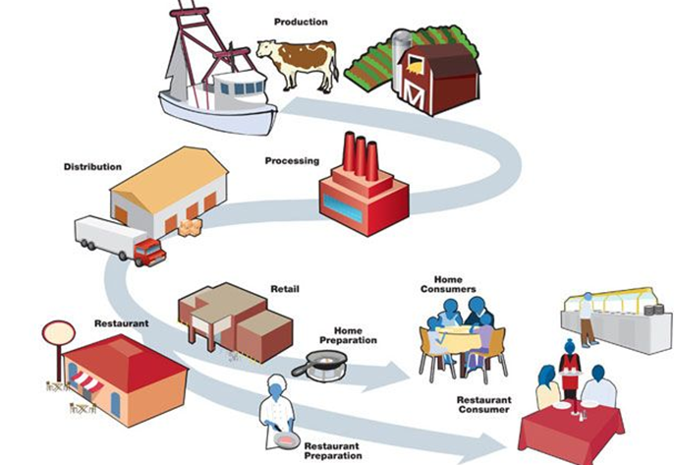
Looking at the whole chain
Prevention efforts have to integrate the full food production chain: from Farm to Fork
Production
Use of Good Practices
Distribution
Processing
Monitor at Critical Control Points
Use clean vehicles and maintain the cold chain
Home Consumers
Retail
Restaurant
Home Preparation
Always follow the 4 Cs of food safety:
Clean
Cook
Combat cross-contamination
Chill
Restaurant Consumer
Use Good Hygiene and Manufacturing Practices
Restaurant Preparation
Notes:
Most present food safety systems are not built according to the principle Farm to Fork.
This has led to some controversy and inefficiency of food safety systems.
It is impossible to provide adequate protection to the consumer by merely sampling and analysing the final product. A comprehensive and integrated farm-to-fork approach is needed.

Slide 7
Steps to Food Safety - The 4 Cs!
Once you take food home from the supermarket and restaurant, you also have an important role to play
Clean – Wash hands and surfaces often
Combat Cross-Contamination – Separate raw meat and seafood from ready-to-eat foods
Cook – Cook to proper temperatures
Chill – Refrigerate promptly
Notes:
Once you take food ....
There are 4 simple steps to do at home to keep food safety
Wash hands and surfaces very often
combat croos-contamination separating raw ...
Cook food to proper temperatures
And
- Refrigerate them promptly

Slide 8
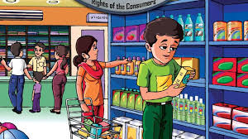
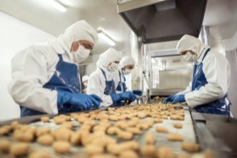
Food Legislation
Food Control Management
Inspection
Food control system
Food Control Authorities
Consumers
Food Producer/ Industry
Government provides consumer protection and ensures that all foods are fit and safe for human consumption
Information/Education/Communication
Consumer has a right to select better quality and safer food of their choice
Food producer/industry is responsible to produce better quality and safer foods
Notes:
Food control systems should be developed and implemented in a transparent manner.
From one side, we have the Food Control Authorities where Governments provides .....
Then we have the Food Producers or Industries who are the responsibles to ....
Finally we have the Consumers who has the right to select .....

Slide 9
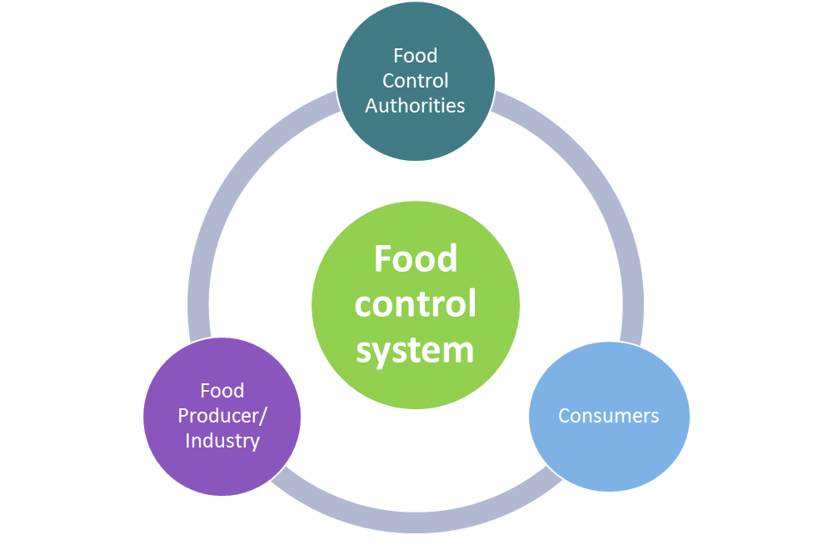
Reduce risk can be achieved
Prevention throughout the food chain: Farm-to-Fork
Food producers and operators are entrusted with primary responsibility for food safety and quality
- Good practices: GAP, GMP, GHP
- HACCP
Government are then responsible for
Auditing performance by monitoring and surveillance
Enforcing legal and regulatory requirements
Notes:
Reduce the risk of contamination can be achieved by prevention throughout the food chain.
The application of prerequisite programs at preharvest, harvest and postharvest level such as Good practices and Hazard Analysis Critical Control Point (HACCP) program is the most effective food safety management strategy.
And Governments are responsible for Auditing … and Enforcing legal …

Slide 10
Food Safety – Challenges
Increasing burden of foodborne illness and new and emerging foodborne hazards
Rapidly changing technologies in food production, processing and marketing
Changes in lifestyles
Growing consumer awareness of food safety and quality issues and increasing demand for better information
International food trade and need for harmonization of food safety and quality standards
Notes:
Many Challenges for food control authorities can rise such as:

Slide 11
Food Control
In many countries, effective food control is undermined by the existence of:
Fragmented legislation
Multiple jurisdictions
Weaknesses in surveillance, monitoring and endorsement

Slide 12
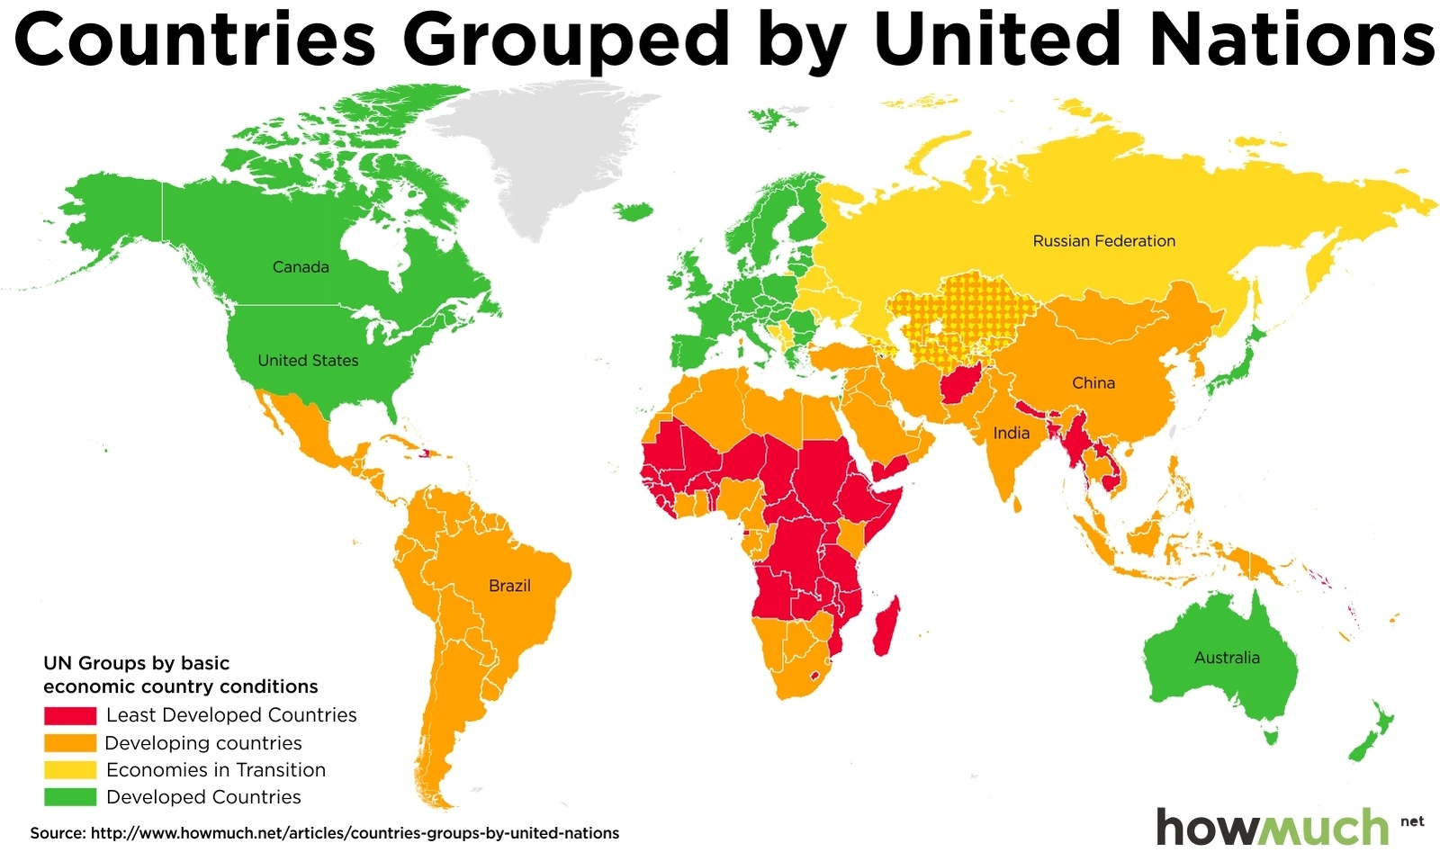
Notes:
We all are aware of this map showing the Global economic country conditions
In green the developed countries
In orange and yellow the developing countries
And in red the least developed countries

Slide 13
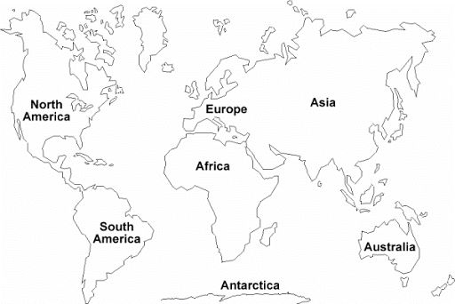
North America (USA & Canada)
Microbiological standards
Advisory Committees on Microbiological Criteria for foods
Different Food Agencies
- FDA, USDA and Health Canada, CFIA (Canadian Food Inspection Agency)
Official Methods for the Microbiological Analysis of Foods
Europe
Microbiological standards
Advisory Committees on Microbiological Criteria for foods
EFSA is the main Food Agency
Official Methods for the Microbiological Analysis of Foods
Asia
Different Microbiological standards
Advisory Committees on Microbiological Criteria for foods
Food safety information
Africa
Prioritizing Food Safety African Union Commission
Regulations governing microbiological standards for foodstuffs and related matters (FAO)
South America
Food Safety Legislation and Regulations:
Colombia – Ministry of Health and Social Protection
Chile – Ministry of Public Health
Argentina – Senasa
Brazil – Anvisa
Peru – Digesa
Building a strategic alliance for sustainable food safety risk analysis - PAN American Health Organization and WHO
Australia & New Zealand
Microbiological standards
Compendium of Microbiological Criteria for Food
- FSANZ (Food Standards Australia New Zealand)
Promoting International Harmonization of Food Standards
WHO, FAO; Codex Alimentarius; Commission on Microbiological Specifications For Foods (ICMSF); World Bank; etc…
Notes:
Given that, we can also see differences about the food safety legislation around the world.
This is a global overview about how the microbiological criteria are applied and by which authorities.

Slide 14
Microbiological criteria
"A risk management metric, which indicates the acceptability of a product, a batch of foodstuffs or a process, based on the absence, presence or number of microorganisms* at a specified point of the food chain"
Epidemiological knowledge
Analytical constraints
Economic feasibility
Political pressure
* Microorganisms include but are not limited to:
– Bacteria, viruses, moulds, yeasts, algae, parasitic protozoa and helminths;
– Their toxins/metabolites;
Notes:
Microbiological criteria are a combination of many factors:

Slide 15
Microbiological criteria
Process Hygiene criteria
Microbiological testing applied to monitor/verify that food safety controls in place are working as intended
Food Safety criteria
Microbiological testing applied to establish the safety of a food lot
Through chain food safety management
(production, processing, food handling controls)
Notes:
The microbiological criteria used by food regulatory agencies generally include:
- Food safety criteria: microbiological criteria that are applied to determine the safety of a food lot
- process hygiene criteria: microbiological criteria applied to verify hygiene measures or control of process.
They are applied at a specified point in the manufacturing process.

Slide 16
Microbiological criteria
The European experience
Regulation 2073/2005 in force since Jan 1, 2006
This Commission Regulation lays down food safety and process hygiene criteria for specific combinations of foodstuffs and microorganisms, their toxins or metabolites.
Chapter 1 – Food Safety criteria
Meat and products thereof
Milk and dairy products
Egg products
Fishery products
Vegetables, fruits and products thereof
Chapter 2 – Process hygiene criteria
https://www.fsai.ie/uploadedFiles/Reg2073_2005(1).pdf
Notes:
Annex I of Commission Regulation (EC) No 2073/2005 lays down food safety and process hygiene criteria for specific combinations of foodstuffs and microorganisms, their toxins or metabolites.

Slide 17
Microbiological criteria
Turkey
Law No 5996: Veterinary services, Plant Health, Food and Feed
Turkish Food Codex – Regulation on Microbiological Criteria
(OG: 29/12/2011; 28157)
This Regulation covers microbiological criteria for foodstuffs and the mandatory rules to be complied with and to be implemented by food business operators.
Annex 1 – Food Safety criteria
Meat and products
Milk and dairy products
Egg products
Water products
Fruits, vegetables and their products
Annex 2 – Process hygiene criteria
Annex 3 – Limits of Pathogens Microorganisms
https://www.tarim.gov.tr/Belgeler/ENG/Legislation/regulation_microbiological_criteria.pdf

Slide 18
Microbiological criteria
Australia and New Zealand
Compendium of Microbiological Criteria for Food (January 2018)
This compendium brings together information on pathogens and indicator organisms significant to food safety; microbiological guideline criteria for ready-to-eat foods, and process hygiene criteria that have been established for specific food commodities.
Section 1
Microbiological guideline criteria for RTE foods
Section 2
Process hygiene criteria
Powdered infant formula products
Raw chicken meat
Appendix 1 – Pathogens
Appendix 2 – Indicator microorganisms
http://www.foodstandards.gov.au/publications/Documents/Compedium%20of%20Microbiological%20Criteria/Compendium_revised-jan-2018.pdf

Slide 19
Microbiological criteria
USA
Different regulation depending on
the type of food.
FOOD CATEGORIES
- Beverages
- Dairy
- Egg products
- Grain-based products
- Meals and entrees
- Meat, pork, poultry products
- Nuts and nut butters
- Produce
- Seafood
- Spices and herbs, coffee and tea
https://www.fsis.usda.gov/wps/wcm/connect/2ea3f473-cd12-4333-a28e-b2385454c967/NACMCF-Report-Process-Control-061015.pdf?MOD=AJPERES
Notes:
They provide the data in tables including the microorganisms that are useful for assessing process control and sanitary conditions during production of foods within the given food category.
The microbiological limits for these microorganisms are provided, as well as recommended actions to be taken if the limits are exceeded.

Slide 20
Control measures
Performance Objective
Performance Objective
Food Safety Objective
Manufacturing
Raw materials
Process
Packaging
Distribution
Retail
Consumer
Raw material control measures:
Supplier HACCP system
Supplier audit program
Verification of microbiological specifications
Raw material storage
Supplier GAP/GMP
Notes:
During the all production chain, control measures need to be taken and objectives to be achieved to ensure that food is safe for its intended use
The food safety objective (FSO) can be defined as a specified maximum frequency and/or concentration of a [microbiological] hazard in a food at the time of consumption, which is deemed to provide an appropriate level of health protection.
The purpose of a PO is to articulate the level of microbial hazard at a particular stage in the food chain that can be tolerated in order to still achieve or contribute to achieving the FSO.

Slide 21
Control measures
Performance Objective
Performance Objective
Food Safety Objective
Manufacturing
Raw materials
Process
Packaging
Distribution
Retail
Consumer
Manufacturing control measures:
Product design (water activity, pH, preservatives, …)
Thermal process
Control of water during production
Cleaning and sanitation program (chemicals, schedule, procedures, training)

Slide 22
Control measures
Performance Objective
Performance Objective
Food Safety Objective
Manufacturing
Raw materials
Process
Packaging
Distribution
Retail
Consumer
Distribution and retail control measures:
Distribution temperature
Storage time
Product handling
Retail storage temperature
Prevent cross-contamination
Pest control

Slide 23
Control measures
Performance Objective
Performance Objective
Food Safety Objective
Manufacturing
Raw materials
Process
Packaging
Distribution
Retail
Consumer
Consumer control measures:
Consumer handling
Storage temperature at home

Slide 24
Microbiological criteria
Example of a possible process hygiene criterion
- m cfu/g is the critical limit
- M cfu/g is the second critical limit
- n samples
- c acceptance number
Two class sampling plan:
n=5, c=0, m=1 000
Means: we sample each batch, take five samples, none of these may exceed 1 000 cfu/g
Three class sampling plan
n=5, c=3, M=10 000, m=1 000
Means: we sample each batch, take five samples, none of these may exceed 10 000 cfu/g and up to three may exceed 1 000 cfu/g
http://apps.who.int/iris/bitstream/handle/10665/249531/9789241565318-eng.pdf;jsessionid=8445B20DDC3799E51C141E2C93406A79?sequence=1
Notes:
When we talk about microbial criteria, we have 4 parameters. m … M … n … c ….
In the case of two class sampling plan, where n=5 c=0 and m=thousand that means that we take 5 samples, none of these may exceed the thousand cfu/g because c=0 and our critical limit is 1000 (m)
In the case of a three class sampling plan, ….
Plans become more stringent as n increases and c, m and M decrease.

Slide 25
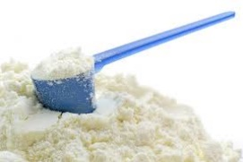
Microbiological criteria - Examples
Powdered infant formula
Australia & New Zealand | (n) | (c) | (m) | (M)
Enterobacteriaceae | 10 | 2 | 0/10g | -
Mesophilic Aerobic Bacteria | 5 | 2 | 500 cfu/g | 5000 cfu/g
Process Hygiene Criteria
Europe | (n) | (c) | (m) | (M)
Enterobacteriaceae | 10 | 0 | 0/10g | -
Salmonella | 30 | 0 | 0/10g | -
Cronobacter sakazakii | 30 | 0 | 0/10g | -
Process Hygiene Criteria and
Food Safety Criteria
Turkey | (n) | (c) | (m) | (M)
Enterobacteriaceae | 10 | 0 | 0/10g | -
Salmonella | 10 | 0 | 0/25g | -
Cronobacter sakazakii | 10 | 0 | 0/25g | -
B. cereus | 5 | 2 | 50 cfu/g | 500 cfu/g
L. monocytogenes | 10 | 0 | 0/25 g | -
Process Hygiene Criteria and
Food Safety Criteria
Notes:
These are examples from each country related to microbiological criteria in powdered infant milk.
In Australia and New Zealand they just have the process hygiene criteria, however in Europe and Turkey they have both, process hygiene criteria and Food Safety Criteria.

Slide 26
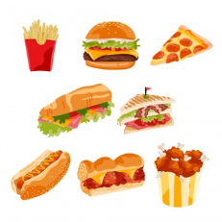
Microbiological criteria - Examples
Listeria monocytogenes and ready-to-eat products
 | (n) | (c) | (m) | (M) | Point of application
Support the growth of L. monocytogenes | 5 | 0 | 100 cfu/g | - | Products placed on the market during their shelf-life
 | 5 | 0 | 0/25g | - | Before the food has left the immediate control of the food business operator
Unable to support the growth of L. monocytogenes | 5 | 0 | 100 cfu/g | - | Products placed on the market during their shelf-life
Notes:
This example defines the food safety criteria for the validation of RTE products regarding presence or number of L. monocytogenes in the end product.
the product shouldn’t exceed the limit of 100 CFU/g of L. monocytogenes throughout the shelf life. This is an European criteria
and, for RTE products that are able to support the growth of L. monocytogenes, the absence of the pathogen in 25 g of sample at the end of the process should be assured. This is a criteria for Europe Turkey and also Australia and New Zealand

Slide 27
Microbiological criteria - Examples
Egg products
Europe | (n) | (c) | (m) | (M)
Enterobacteriaceae | 5 | 2 | 10 cfu/g | 100 cfu/g
Salmonella | 5 | 0 | 0/25g | -
Process Hygiene Criteria and
Food Safety Criteria
Turkey | (n) | (c) | (m) | (M)
Enterobacteriaceae | 5 | 2 | 10 cfu/g | 100 cfu/g
Salmonella | 5 | 0 | 0/25g | -
US | (n) | (c) | (m) | (M)
Salmonella | 4 | 0 | 0/25g | -
Food Safety Criteria
Notes:
In Europe and turkey, egg products and ready-to-eat (RTE) foods containing raw egg are subject to a food safety criterion for Salmonella and a process hygiene criterion for Enterobacteriaceae.
However, in US they just have food safety criteria for salmonella and if we compare with the previous ones, the US are more stringent as they analyse four samples instead of five in Europe and turkey.

Slide 28
Microbiological criteria - Examples
Histamine and Seafood
The Codex Alimentarius Commission standards for seafood products a limit of <200 ppm
In the US, a sampling plan n = 6, c = 1, m = 50 ppm, M = 500 ppm is applied.
In Europe, a sampling plan n = 9, c = 2, m = 100 ppm, M = 200 ppm is recommended.
In Australia & New Zealand, the level must not exceed 200 ppm.
Notes:
In the case of Histamine, the codex Alimentarius standards for …
But Approaches for testing for histamine vary between regions and the limits are also different
For example, in the US, ….
In Europe …
In Australia ….

Slide 29
Final Remarks
Limits and sampling for in-process and environmental tests are greatly influenced by the site, process, geographic region and other factors, therefore it is not possible to specify limits that are universally applicable in all situations.
The availability of a risk assessment, dose-response data, consumer exposure data and defined Food Safety Objective, and data on microbial levels typically encountered in a food, facilitates development of microbiological criteria that have a link to public health goals.
Notes:
To finalize, I want to remark that ....

Slide 30
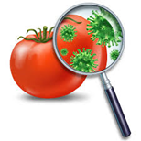
THANK YOU
FOR YOUR KIND ATTENTION
THANK YOU
FOR YOUR KIND ATTENTION

