Slide 1
Development and application of modern methods for the detection and quantification of residues and contaminants in milk
‘On the road to Innovation Union: European food legislation’
Dr Martin Danaher,
Head of National Reference Laboratory,
Food Safety Department, Teagasc Food Research Centre,
Ashtown, Dublin 15, Ireland.
FOODstars

Slide 2
What are residues?
Residues can arise in milk and milk products from the following sources:
  Use of licensed veterinary drugs for treatment of dairy cows.
  Illegal use of banned drugs or growth promoting agents.
  Pesticides used at farm level to control insect infestations
  Contaminants from Animal Feed or the environment e.g. mycotoxins or PCBs.
  Chemicals used to ensure good hygiene at farm and processing plants.

Slide 3
Antiparasitic drugs
Control of
- Nematodes (roundworms)
- Cestodes (tapeworms)
- Trematodes (flukes)
3 classes of drugs:
- Benzimidazoles
- Macrocyclic Lactones
- Flukicides
  Some drugs are teratogenic or neurotoxic
  Many products not licensed in lactating animals
Use and hazard
Closantel
Rafoxanide
Analysis
  Detection: HPLC-UV/FLD and LC-MS/MS
Nitroxynil

Slide 4
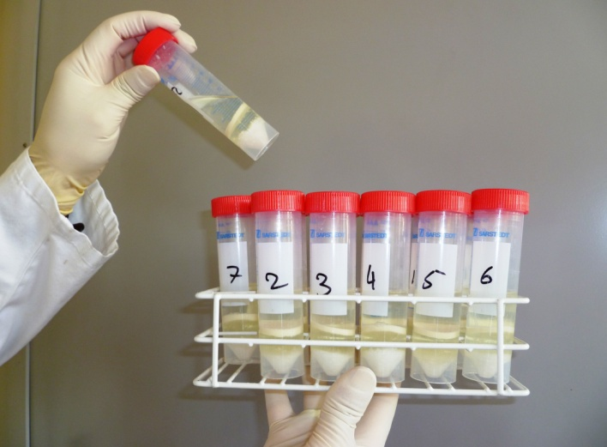
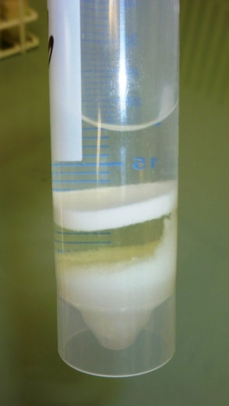
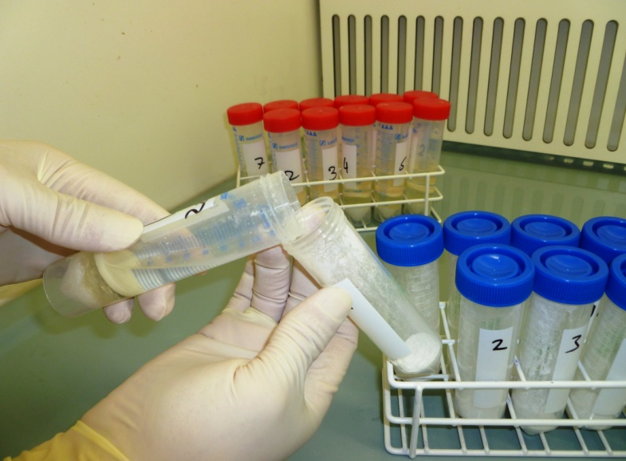
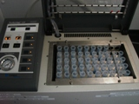
QuEChERS Approach
4g MgSO₄ + 1g NaCl
1.5g MgSO₄ +
0.5g C₁₈
Phase Separation
D-SPE
6 mL Supernatant +
0.5 mL DMSO
Analysis
Concentration

Slide 5
Anthelmintic drugs
Abamectin | Mebendazole | Levamisole
Doramectin | Hydroxy Mebendazole | Coumaphos
Emamectin | Amino Mebendazole | Coumaphos-Oxon
Eprinomectin | Flubendazole | Rafoxanide
Ivermectin | Hydroxy Flubendazole | Oxyclozanide
Moxidectin | Amino Flubendazole | Niclozamide
- | Fenbendazole | Nitroxinil
Albendazole | Fenbendazole Sulphone | Haloxon
Albendazole Sulphone | Oxfendazole | Clorsulon
Albendazole Sulphoxide | Triclabendazole | Closantel
Albendazole amino sulphone | Triclabendazole Sulphone | Morantel
Cambendazole | Triclabendazole Sulphoxide | Bithionol
Thiabendazole | Keto-triclabendazole | Bithionol-Sulphoxide
5 Hydroxy-Thiabendazole | Oxibendazole

Slide 6
Triclabendazole Persistence in milk

Slide 7
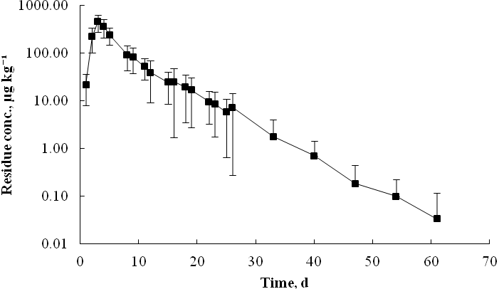
Rafoxanide Persistence lactating cows

Slide 8
Nitroxynil Persistence in milk
Cows treated with Trodax® 34%
Milk samples twice daily over a 16 days, then weekly until day 58

Slide 9
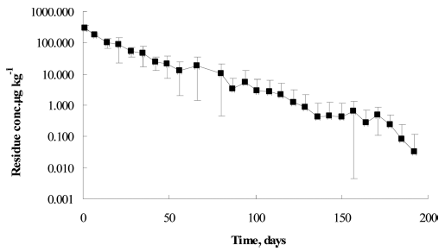
Closantel Persistence lactating cows

Slide 10
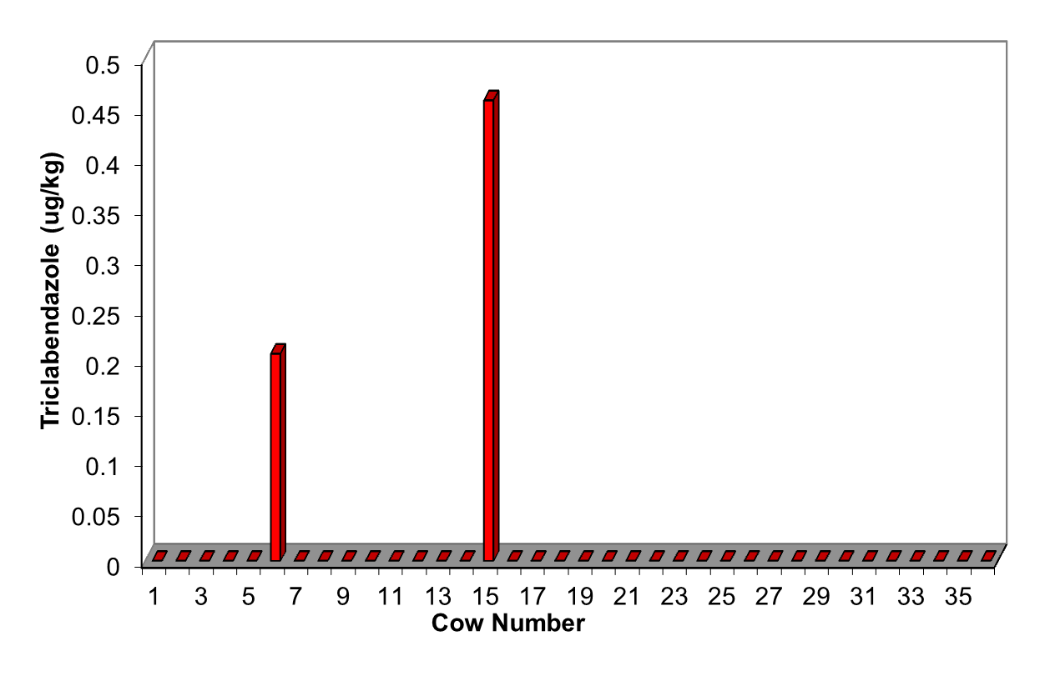
Triclabendazole Persistence (dry cows)
56 d
Fasinex 10% oral dose
Sampling 49 to 64 days
56 d

Slide 11
Nitroynil Persistence in milk (dry cows)

Slide 12
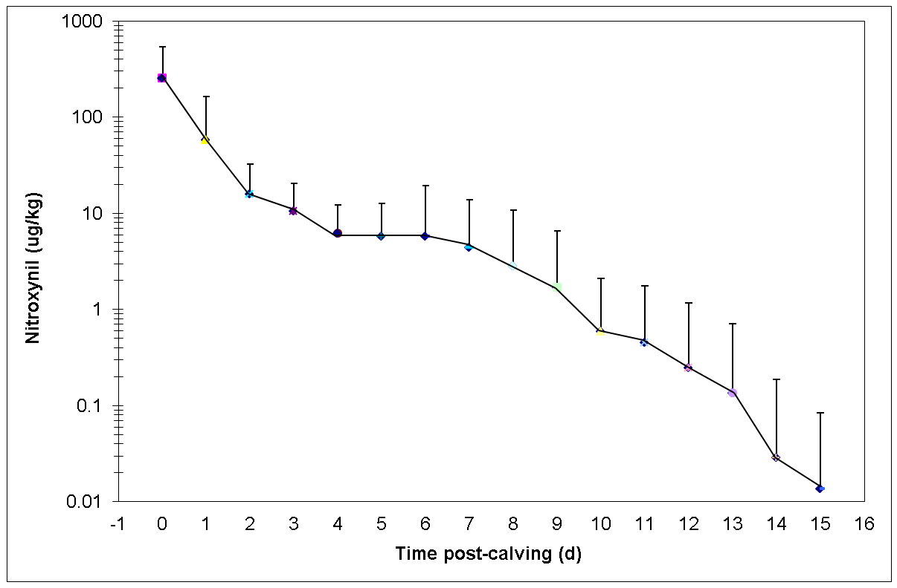
Nitroxynil Persistence in milk (dry cow)

Slide 13
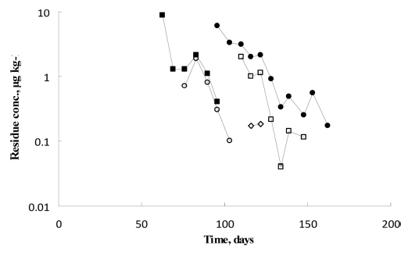
Closantel Persistence in milk (dry cow)
Closantel - dry cow treatment

Slide 14
New EU MRLs
Triclabendazole 10 ppb
Closantel 45 ppb
Clorsulon 16 ppb
Nitroxynil 20 ppb
Rafoxanide 10 ppb

Slide 15
Improving chemical analysis of
Beta-lactam antibiotics

Slide 16
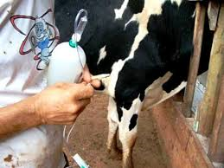
β-Lactams usage in animal products
Penicillins and Cephalosporins:
Oral, parenteral and intramammary
administration
Therapeutic use in ruminants, monogastrics and poultry
Prophylactically at sub-therapeutic doses
Carbapenems:
Not licensed in food-producing animals

Slide 17
Issues with current approaches
No multi-residue LC-MS/MS methods incorporating cephalosporins currently available in Ireland
Outsource of samples to other countries for confirmatory analysis
  Long turnaround time
  Degradation of samples during transport
    Impact on integrity of results
  Cost implications

Slide 18
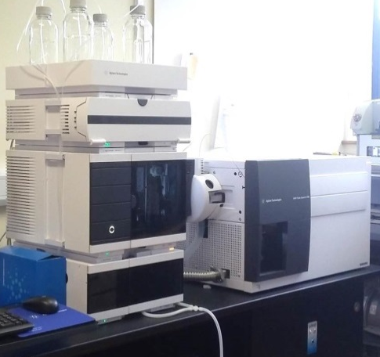
Method overview for milk
Weigh 2 g
of milk
Add 100 µL
of isotope std
Add 1 mL H₂O & 7 mL MeCN
Vortex 1 min
Centrifuge 3500 rpm (15 min, 4°C)
d-SPE clean-up
(500 mg C₁₈)
Centrifuge 2800 xg (15 min, 4°C)
N₂-EVAP
5 mL to <1 mL
Reconstitute to 1 mL, filter

Slide 19
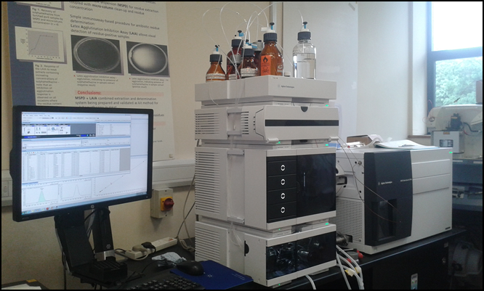
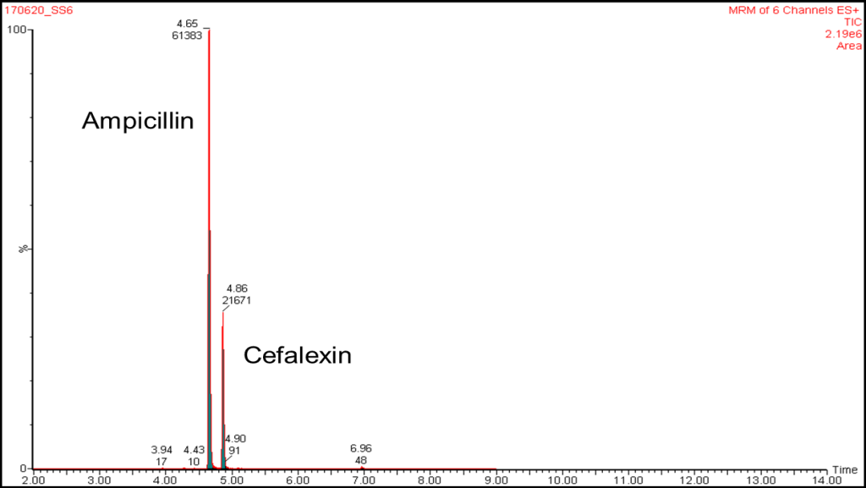
Chromatography conditions
Analytical column: Agilent Phenyl Hexyl column
Binary gradient of:
Mobile phase A: HCOOH 0.01% + 0.2 mM
ammonium acetate in water
Mobile phase B: HCOOH 0.01% in acetonitrile
Column temperature: 30°C
Flow rate: 0.4 mL min⁻¹
Injection volume: 10 µL
Run time = 12 min

Slide 20
Analysis of cefquinome in dairy products
Matrix | Fortification level (μg kg⁻¹) | Mean ± SD (μg kg⁻¹) | RSD(%) | Trueness(%)
Liquid samples (samples = 11; days = 5)
Milk | 4.0 | 4.1 ± 0.15 | 3.8 | 101
 | 250 | 258 ± 9.8 | 3.8 | 103
Skimmed milk | 4.0 | 4.0 ± 0.26 | 6.4 | 100
 | 250 | 251 ± 8.8 | 3.5 | 100
Buttermilk | 4.0 | 3.5 ± 0.33 | 9.3 | 87
 | 250 | 226 ± 7.9 | 3.5 | 91
Whey | 4.0 | 3.5 ± 0.20 | 5.8 | 86
 | 250 | 214 ± 5.6 | 2.6 | 85
Cream | 4.0 | 4.0 ± 0.20 | 5.1 | 99
 | 250 | 256 ± 9.2 | 3.6 | 102
Solid samples (samples = 11; days = 3)
Curd | 4.0 | 3.6 ± 0.25 | 6.8 | 90
 | 250 | 237 ± 5.5 | 2.3 | 95
Cheese | 4.0 | 3.9 ± 0.34 | 8.6 | 98
 | 250 | 244 ± 7.5 | 3.1 | 97
Butter | 4.0 | 3.9 ± 0.16 | 4.1 | 99
 | 250 | 259 ± 7.2 | 2.8 | 104

Slide 21
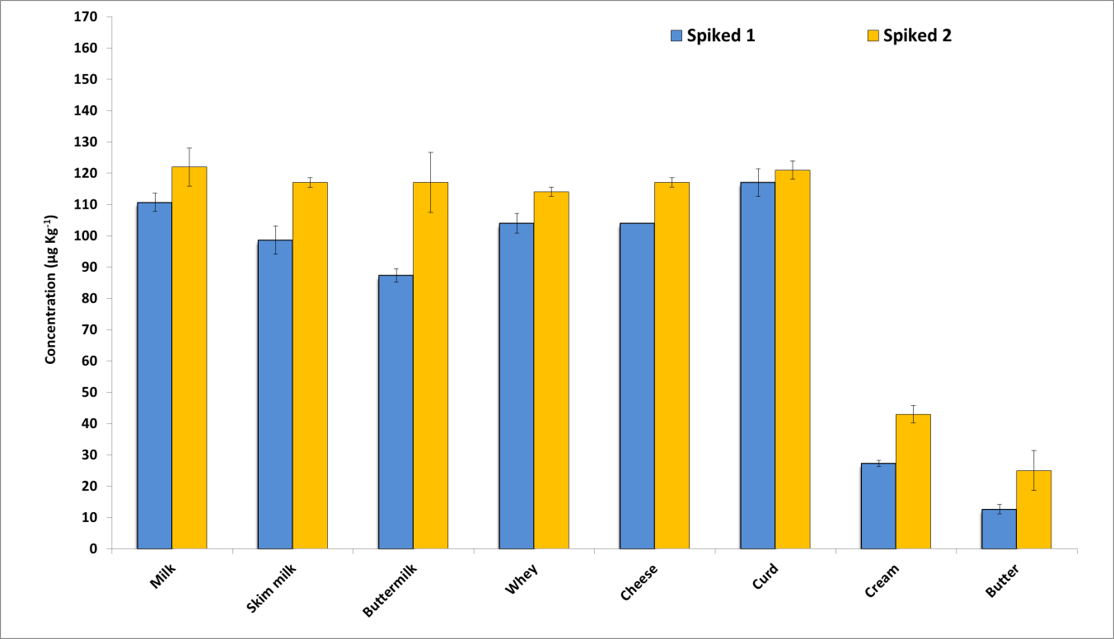
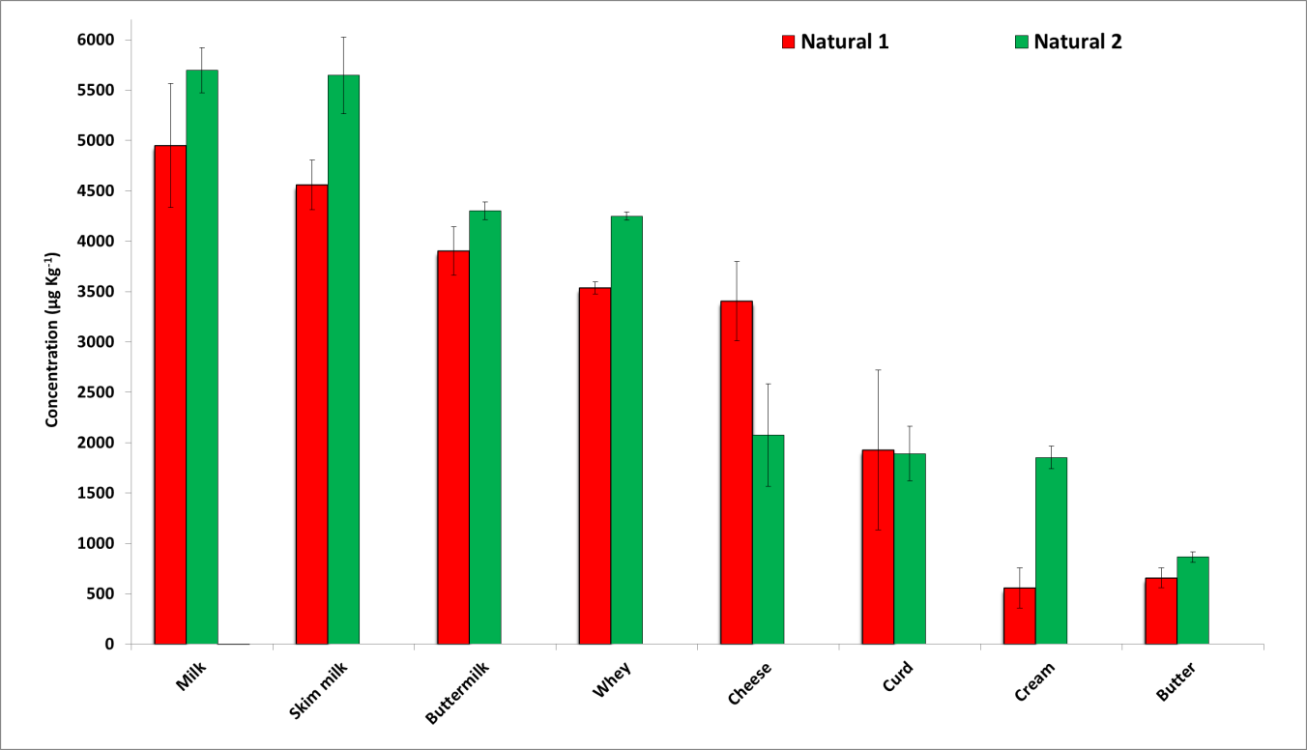
(n = 3)
Spiked studies
(n = 3)
Animal treatment studies

Slide 22
Emerging residues:
Analysis of Chlorate &Perchlorate Residues

Slide 23
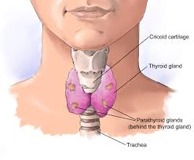
Toxicological concern
  Concern because chlorates are a
  competitive inhibitor of iodine uptake in the thyroid.
  Its presence in food a potential health concern for vulnerable groups, particularly infants, pregnant women and people with thyroid dysfunction.
  Can cause damage to red blood cells.

Slide 24
Analytical challenge
Very small polar molecules, which make it difficult to achieve selective analysis.
Need selective detection i.e. MS or MS/MS to achieve low levels of detection.
Due to high water solubility speciality chromatographic columns or ion chromatography is required.

Slide 25
Objectives
  To develop a rapid LC-MS/MS method capable of measuring Chlorate residues to 0.002 mg/kg and 0.01 mg/kg in milk and SMP, respectively.
  To develop a rapid sample preparation protocol capable of processing >100 samples in one day.
  To verify the accuracy of the method through method validation and inter-laboratory studies.
  To gain ISO17025 accreditation for the method.

Slide 26
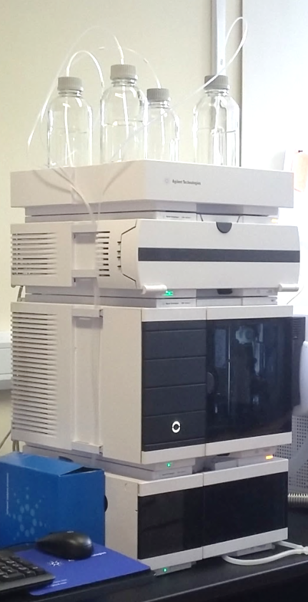
LC Separation Conditions
Column: Poroshell PFP 120, 50 x 2.1mm (1.9 µm)
Temp: 40°C
Mobile phase A: 1% Acetic Acid in Water
Mobile phase B: Methanol
Flow: 0.6 mL/ min
Gradient: 0 min 100% A
0.99 min 100% A
1.0 min 0% A
1.79 min 0%A
1.80 min 100%A
2.8 min 100%A
Run Time: 2.8 min
Injection Volume: 2 µL
Needle Wash: Methanol:Water (50:50, v/v)

Slide 27
QqQ MS Conditions
Electrospray ionisation with Jet Stream Source
Drying Gas: 150°C, 8 L/min
Sheath Gas: 400°C, 11L/min.
Nebuliser: 45 psi
Capillary: 2000V
Nozzle: 0
MS Conditions
ESI Polarity: Negative
Scan Type: Dynamic MRM
Cycle time: 500 ms
ΔEMV: 0V
Compound | Transition (m/z) | Dwell | FV | CE | CAV
Chlorate | 84.9>68.9 82.9 > 66.9 | 124 | 50 | 19 27 | 4 4
¹⁸O₃-Chlorate | 89 > 71 | 124 | 50 | 27 | 4
Perchlorate | 101 >84.9 99>92.9 | 124 | 128 | 31 31 | 4 4
¹⁸O₃-Chlorate | 107 > 88.9 | 124 | 128 | 35 | 4

Slide 28
Sample Preparation Milk Powders
*
*
Weigh 1g
of Powder
Add 100 µL Isotopically labelled internal standard
Centrifuge 10 min @ 3500 rpm
Take 2ml (~2g)
skimmed milk
Add 8 ml ACN and 100 µl acetic acid
Shake at 200 rpm
for 20 min
Centrifuge 10 min @ 3500 rpm
Take 5 ml and Conc. under N₂, @ 30 ºC
Filter (0.2 µm PTFE) and inject in UHPLC-MS/MS
Add 8.9 mL of water
Vibrational Shaker (1 min)
Dissolute Water bath 40°C (20 min)

Slide 29
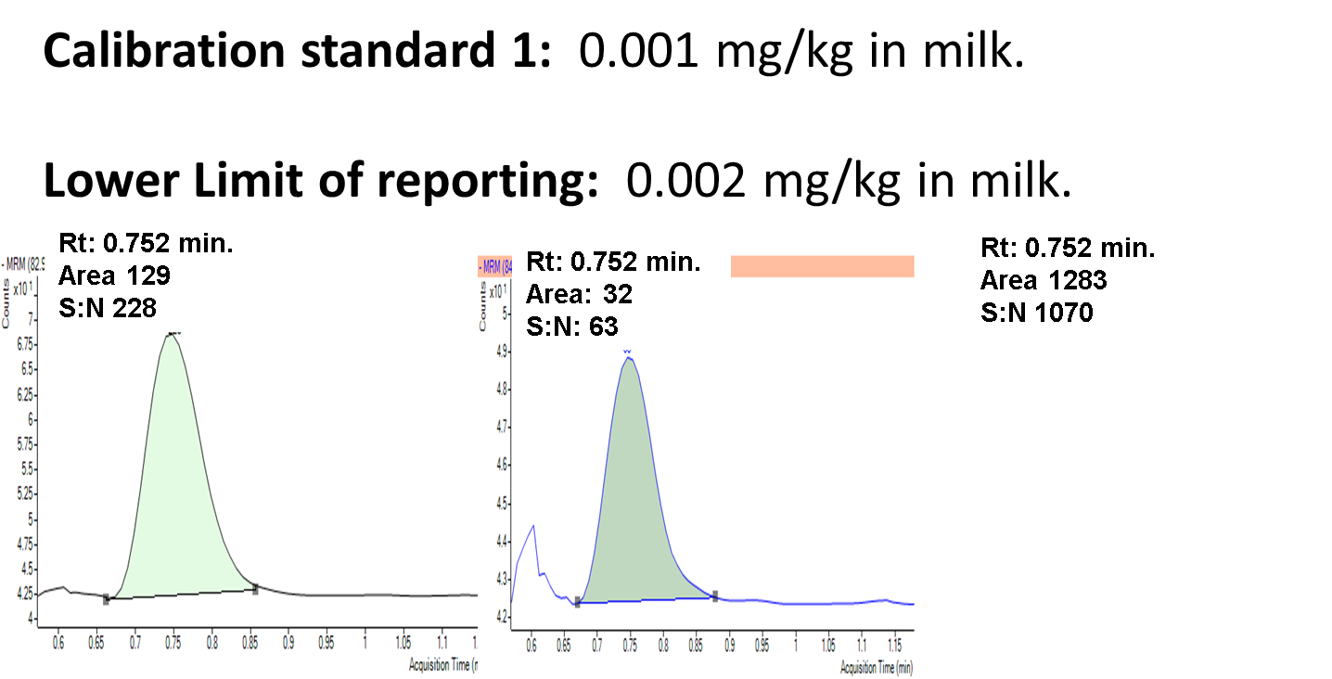
Method Sensitivity: Chlorate

Slide 30
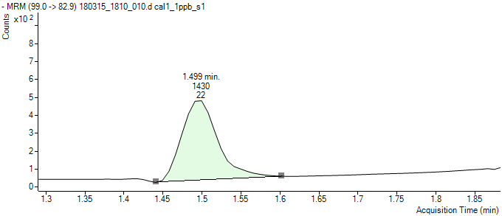
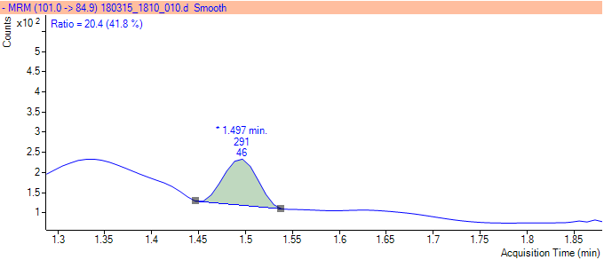
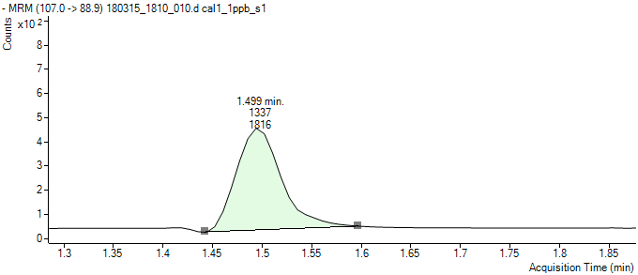
Method Sensitivity: Perchlorate
Calibration standard 1: 0.001 mg/kg in milk.
Lower Limit of reporting: 0.002 mg/kg in milk.
Rt: 1.499 min.
Area 1420
S:N 22
Rt: 1.499 min.
Area 1337
S:N 1816
Rt: 1.497 min.
Area: 291
S:N: 46
Quantitation Qualification Internal Standard

Slide 31
Accuracy and Precision
 |  | Between days study (n =2 x 10d)
Analyte | Fortification Level (µg/kg) | Mean (µg/kg) | S.D. (µg/kg) | CV (%) | Trueness (%)
Chlorate | 2 | 2.04 | 0.18 | 8.6 | 92-112
 | 100 | 99.0 | 2.5 | 2.5 | 95-105
Perchlorate | 2 | 2.04 | 0.13 | 6.2 | 95-108
 | 100 | 98.8 | 1.46 | 1.48 | 94-101

Slide 32
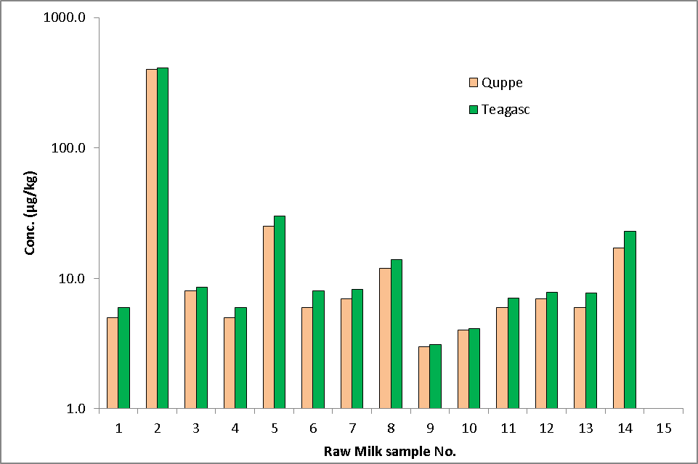
Milk Comparison (inter-lab)

Slide 33
Summary
  Method developed to measure chlorate and perchlorate residues in milk and SMP.
  Method performance was evaluated through single lab validation and inter-lab studies.
  This rapid method is capable of analysing 200 test samples per day with 3-4 analysts preparing samples.
  Samples are rapidly analysed in a 16 h overnight LC-MS/MS run.
  Method was accredited in March 2017.

Slide 34


New EU MRLs
http://www.inab.ie/FileUpload/Testing/Teagasc-038T.pdf

Slide 35

THANK YOU
FOR YOUR KIND ATTENTION

